Slide 1
Disclaimer
These slides are intended as presentation aids for the lecture. They contain information that would otherwise be to difficult or time-consuming to reproduce on the board. But they are incomplete, not self-explanatory, and are not always used in the order they appear in this presentation. As a result, these slides should not be used as a script for this course. I recommend you take notes during class, maybe on the slides themselves. It has been shown that taking notes improves learning success.

Slide 2
Reading for this set of slides
Craig – Intro to Robotics (3rd Edition)
Chapter 2, Appendix B
Please note that this set of slides is intended as support for the lecture, not as a
stand-alone script. If you want to study for this course, please use these slides
in conjunction with the indicated chapters in the text books. The textbooks are
available online or in the TUB library (many copies that can be checked out for the entire semester. There are also some aspects of the lectures that will not be
covered in the text books but can still be part of the homework or exam. For those
It is important that you attend class or ask somebody about what was covered in class.

Slide 3
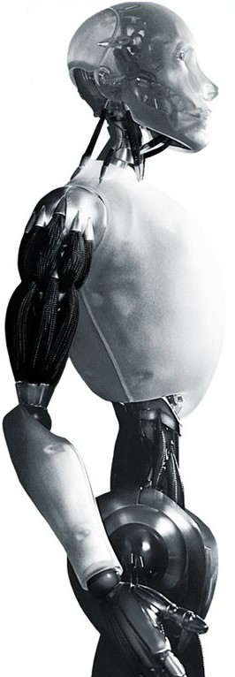
Robotics Representations of Orientation
TU Berlin
Oliver Brock
Notes:
TEST. FOR EVER ouverte OUIVER OLIVER

Slide 4

X-Y-Z Fixed Angles (roll, pitch, yaw)
(π/2, π/2, π/2)
z
z
z
z
y
y
y
y
x
x
x
x
Other combination of axes exist.
Notes:
Rotation is performed about the axes of a fixed frame.

Slide 5
Z-X-Z Euler Angles
(π/2, π/2, π/2)
z
z
y
x
y
x
y
x
y
x
z
z
Other combination of axes exist.

Slide 6
Arbitrary Axis
Direction of vector indicates axis Â
|Â| = 1, so only two numbers are required
Magnitude given by angle θ
z
Â
θ
y
x

Slide 7
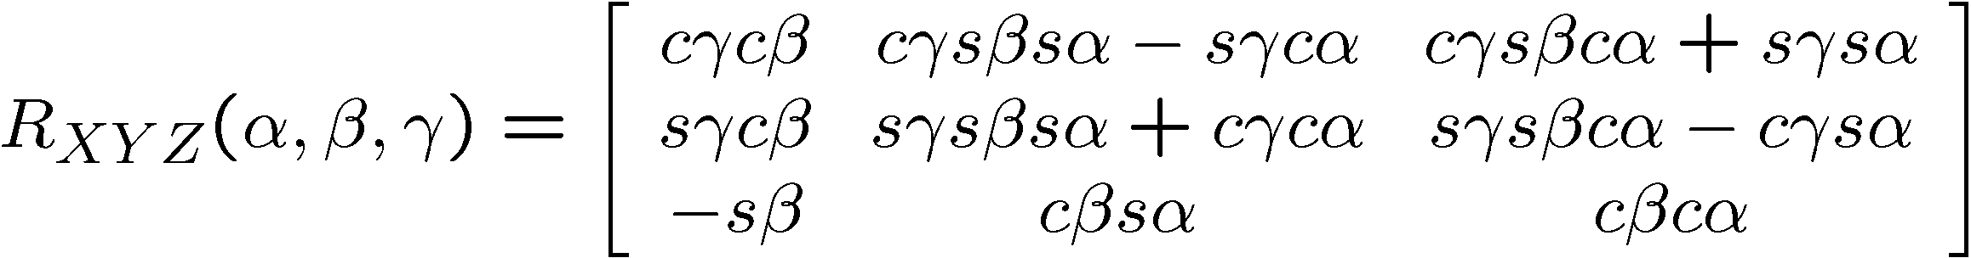
Conversions
Exist between all representations (see Appendix B of Craig)
For example, XYZ fixed angle to rotation matrix:

Slide 8
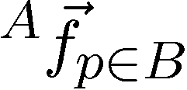
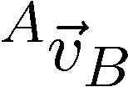
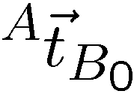


Line Vector vs. Free Vector
Velocity Vector
only depends on magnitude and direction
Force Vector
depends on line of action
and point of application,
in addition to magnitude
and direction
Position Vector
depends on line of action
and point of application,
in addition to magnitude
and direction

Slide 9
Problems with Rotation
Rotation matrices are used most often, but
numerical error buildup
interpolation
complexity of multiplication
Angle representations
address numerical error buildup
but have degeneracies (Gimbal problem)
Arbitrary axis representation introduces
zero rotation problem
Notes:
Image from: http://en.wikipedia.org/wiki/Gimbal_lock
Gimbal lock on Apollo 11
A well-known gimbal lock incident happened in the Apollo 11 Moon mission. On this spacecraft, a set of gimbals was used on an inertial measurement unit (IMU). The engineers were aware of the gimbal lock problem but had declined to use a fourth gimbal.^{[5]} Some of the reasoning behind this decision is apparent from the following quote:
"The advantages of the redundant gimbal seem to be outweighed by the equipment simplicity, size advantages, and corresponding implied reliability of the direct three degree of freedom unit."
—David Hoag, Apollo Lunar Surface Journal
They preferred an alternate solution using an indicator that would be triggered when near to 85 degrees pitch.
"Near that point, in a closed stabilization loop, the torque motors could theoretically be commanded to flip the gimbal 180 degrees instantaneously. Instead, in the LM, the computer flashed a 'gimbal lock' warning at 70 degrees and froze the IMU at 85 degrees"
—Paul Fjeld, Apollo Lunar Surface Journal
Rather than try to drive the gimbals faster than they could go, the system simply gave up and froze the platform. From this point, the spacecraft would have to be manually moved away from the gimbal lock position, and the platform would have to be manually realigned using the stars as a reference.^{[6]}
After the Lunar Module had landed, Mike Collins aboard the Command Module joked "How about sending me a fourth gimbal for Christmas?"

Slide 10
Quaternions
Address:
numerical error buildup
interpolation
complexity of multiplication (among themselves)
But:
eliminate homogeneity
are inefficient when many points are rotated (then we convert them into a matrix before performing the rotation)

Slide 11

Notes:
Illustrate what happens when a 2DOF rotational robot arm loses 1 DOF
Background image
https://www.pexels.com/photo/background-black-blackboard-board-159770/

